Slide 1

Welcome to…
Roosevelt Elementary’s
Computer Lab!

Slide 2

My name is Ms. Moeai
I’m here to teach you about technology and
help your teacher show you how to do
all kinds of fun things on computers!
And if something breaks…
I’ll be here to fix it.

Slide 3

Computers can be a
LOT of FUN!
But they are also very delicate,
And very BREAKABLE…
If they’re not handled with care, of course.

Slide 4

So that’s why I made…
THE RULES
OF THE
ROAD!

Slide 5

Line up QUIETLY outside
the Computer Lab door.
WALK quietly into the lab.
SHH!!
Always use your
INSIDE VOICE…

Slide 6

WAIT for instructions
before touching equipment.
Use equipment RESPECTFULLY.
Only CLEAN HANDS touch equipment.

Slide 7
Using the Computer
Use only programs that the class is using. You MUST have permission before going to websites or applications that were not approved beforehand!
Do not change icons, mouse, settings.
Listen and do what the teacher asks you to do.
Treat the keyboard and mouse gently.
If something inappropriate shows on your screen, turn off the monitor and tell Ms. Moeai.

Slide 8
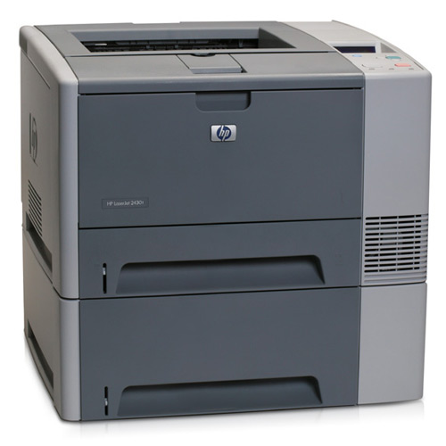



Printing
You must always ask permission before
printing anything! Be sure to have your
teacher check your work before
you print.
If you hear the signal…
Stop. Look. Listen.
Stop what you’re doing and look to
Ms. Moeai for directions.

Slide 9
Leaving the Lab
Close out of all programs and websites.
Put your headphones, mouse, and keyboard,
where they were.
Log Off
Line up QUIETLY.
Wait for Ms. Moeai or your teacher to dismiss you.

Slide 10

Let’s have a SAFE
and FUN
year!

