Slide 2
I’ve always lived in Dinkerville,
My friends all live here too.
We go to Diffendoofer School—
We’re happy that we do.

Slide 3
Our school is at the corner
Of Dinkzoober and Dinkzott.
It looks like any other school,
But we suspect it’s not.
I think we’re learning lots of things
Not taught at other schools.
Our teachers are remarkable
They make up their own rules.

Slide 4
Miss Bobble teaches listening,

Slide 5
Miss Wobble teaches smelling.

Slide 6
Miss Fribble teaches laughing,

Slide 7
And Miss Quibble
teaches yelling.

Slide 8
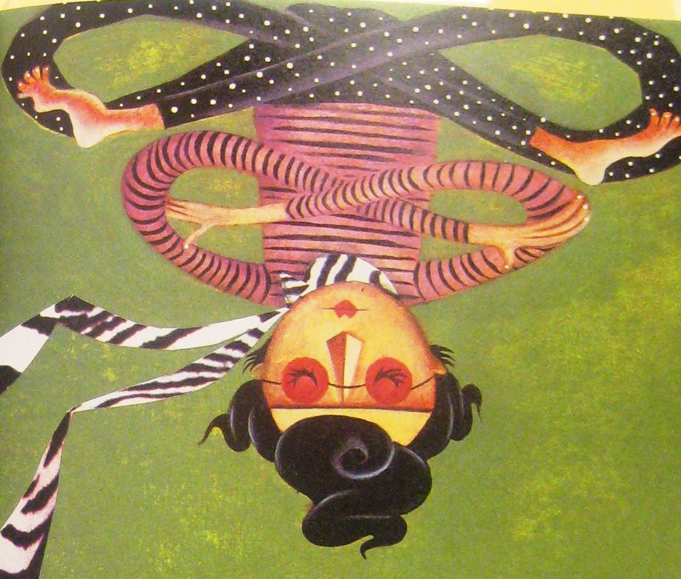
Miss Twining teaches tying knots
In neckerchiefs and noodles,
And how to tell chrysanthemums
From miniature poodles.

Slide 9
Miss Vining teaches all the ways
A pigeon may be peppered,
And how to put a saddle
On a lizard or a leopard.

Slide 10
My teacher is Miss Bonkers,
She’s as bouncy as a flea.
I’m not certain what she teaches,
But I’m glad she teaches me.

Slide 11
“Look! Look!” she chirps.
“I’ll show you how…
To tell a cactus from a cow,
And then I shall instruct you
why…
A hippo cannot hope to fly.”

Slide 12
She even teaches frogs to
dance,
And pigs to put on
underpants.
One day she taught a duck
to sing—
Miss Bonkers teaches
EVERYTHING!
Of all the teachers in our
school,
I like Miss Bonkers best.
Our teachers are all different,
But she’s different-er
than the rest.

Slide 13
We also have a principal,
His name is Mr. Lowe.
He is the very saddest man
That any of us know.
He mumbles, “Are they learning
This and that and such and
such?”
His face is wrinkled as a prune
From worrying so much.
He breaks a lot of pencil points
From pushing down too hard,
And many dogs start barking
As he mopes around the yard.
We think he wears false eyebrows.
In fact, we’re sure it’s so.

Slide 14
We’ve heard he takes them off at night…
I guess we’ll
never know.

Slide 15
But we know he likes
Miss Bonkers,
He treats her like a queen.
He’s always there to watch her
When she’s on her trampoline.

Slide 16
There are many other people
Who make Diffendoofer run.
They are utterly amazing—
I love every single one.

Slide 17
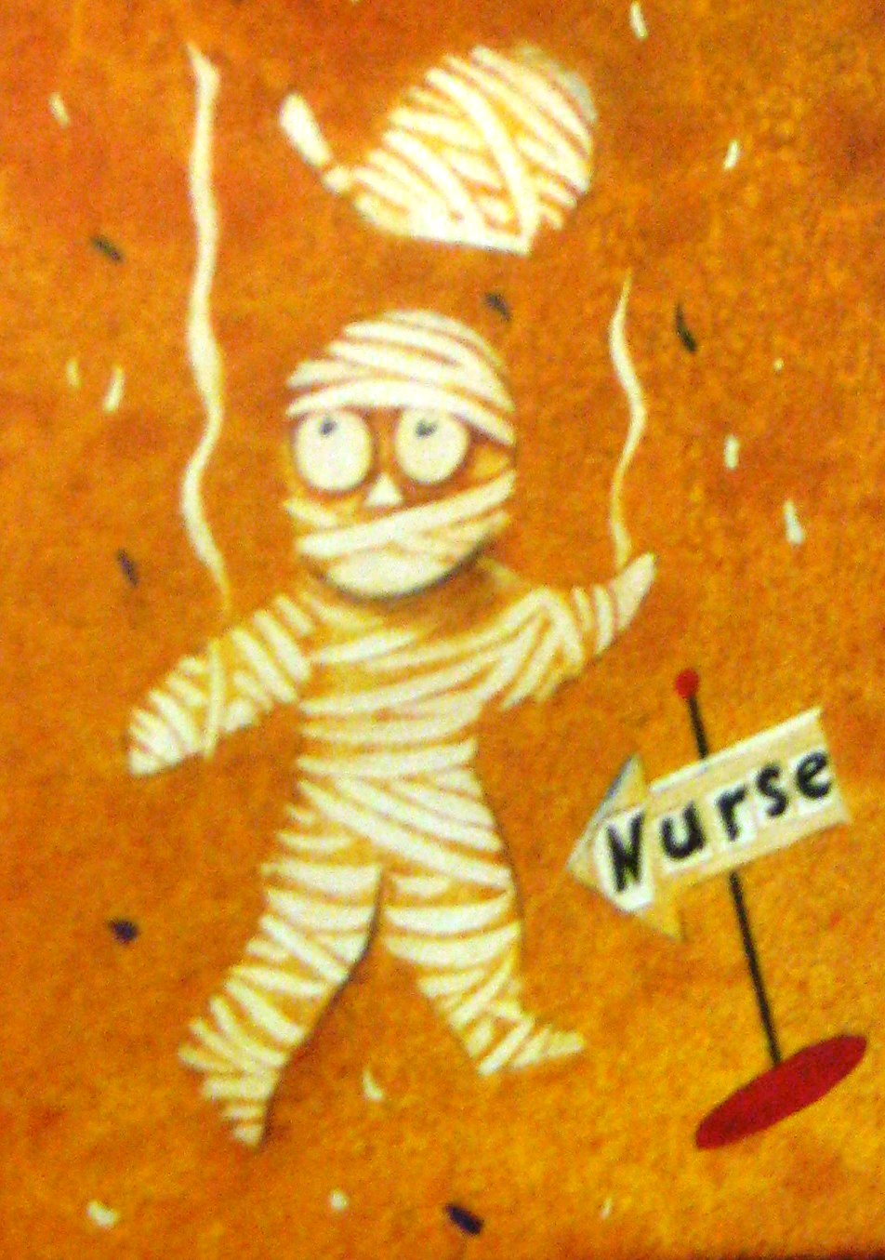
Our nurse, Miss Clotte,
knows what to do
When we’ve got sniffles or
the flu.
One day I had a splinter so…
She bandaged me from head
to toe.

Slide 18
Mr. Plunger, our custodian,
Has fashioned a machine—

Slide 19
A
Super…
Zooper…
Flooper-Do—
It
Keeps
The
Whole
School
Clean.

Slide 20
Our music teacher, Mrs. Fox,
Makes bagpipes out of straws
and socks.

Slide 21
Our art instructor, Mr. Beeze,
Paints pictures hanging by his
knees.

Slide 22
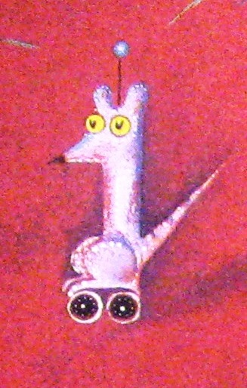
In science class with Mr. Katz,
We learn to build robotic rats.

Slide 23
In gym we watch as Mr. Bear
Hoists elephants into the air.

Slide 24
Miss Loon is our librarian,
She hides behind the shelves,

Slide 25
And often cries out, “Louder!”
When we’re reading to
ourselves.

Slide 26
We have three cooks, all named McMunch,
Who merrily prepare our lunch.

Slide 27
They make us hot dogs,
beans, and fries,
Plus things we do not
recognize.
And as they cook, they sing
their song,
Not too short and not too
long.
“Roast and toast and slice
and dice,
Cooking lunch is oh so nice.”

Slide 28
We were eating their
concoctions,
Telling jokes and making
noise,
When Mr. Lowe appeared and
howled,
“Attention, girls and boys!”

Slide 29
He began to fuss and fidget,
Scratch and mutter, sneeze
and cough.
He shook his head so hard,
we thought
His eyebrows would come
off.
He wrung his hands, he
cleared his throat,
He shed a single tear,

Slide 30
Then sobbed, “I’ve something to
announce,
And that is why I’m here.
All schools for miles and miles
around
Must take a special test,
To see who’s learning such and
such—
To see which school’s the best.

Slide 31
“…If our small school does not
do well,
Then it will be torn down,
And you will have to go to
school
In dreary Flobbertown.”

Slide 32
“Not Flobbertown!” we shouted,
And we shuddered at the
name,
For everyone in Flobbertown
Does everything the same.
It’s miserable in Flobbertown,
They dress in just one style.
They sing one song, they
never dance,
They march in single file.
They do not have a
playground,
And they do not have a park.
Their lunches have no taste at
all,
Their dogs are scared to bark.

Slide 34
Miss Bonkers rose. “Don’t’ fret!”
she said.
“You’ve learned the things you
need
To pass that test and many
more—
I’m certain you’ll succeed.
We’ve taught you that the earth
is round,
That red and white make pink,
And something else that matters
more—
We’ve taught you how to think.”

Slide 35
“I hope you’re right,”
sighed Mr. Lowe.
He shed another tear.
“The test is in ten
minutes,
And you’re taking it
right here.”

Slide 36
We sat in shock and disbelief.
“Oh no!” we moaned. “Oh no!”
We were even more unhappy
Than unhappy Mr. Lowe.

Slide 37
But then the test was handed out.
“Yahoo!” we yelled. “Yahoo!:
For it was filled with all the things
That we all knew we knew.

Slide 38
There were questions about
noodles,
About poodles, frogs, and
yelling,

Slide 39
About listening and
laughing,
And chrysanthemums and
smelling.

Slide 40
There were questions about other things
We’d never seen or heard,
And yet we somehow answered them,
Enjoying every word.

Slide 42
One week later, after recess,
Mr. Lowe meandered in.
We’d never seen him smile before,
But now he wore a grin.

Slide 43
He soon began to giggle,
Then his giggle grew by half,
And then it really happened—

Slide 44
…Mr. Lowe began to laugh.

Slide 45
“You’ve saved our school!
You’ve saved our school!
He jubilantly roared.
“We got the very highest score!”
He wrote it on the board.

Slide 47
Miss Bonkers did some
cartwheels
Till her face turned cherry red.
She bounded up to Mr. Lowe
And kissed him on the head.
“Hooray! Hooray!” She shouted.
“I’m so proud I cannot speak.”
So she did another cartwheel,

Slide 48
And she pecked him on the
cheek.

Slide 49
“Ahem! Ahem!” coughed Mr.
Lowe.
“You all deserve a bow.
I thus declare a holiday—
It starts exactly now.
Because you’ve done so
splendidly
In every sort of way,
This day forever shall be known
As Diffendoofer Day.
And furthermore, I promise
I won’t ever wear a frown.
For now I know we’ll never go
To dreary Flobbertown.

Slide 50
Then we held a celebration.
There was pizza, milk, and
cake.
Like everyone, I ate too much
And got a bellyache.
We laughed and whooped and
hollered
The entire school day long,
Then we all sang,
triumphantly,
“The Diffendoofer Song.”

Slide 57
The End
PowerPoint
by Pam Moeai
2008

