Slide 1
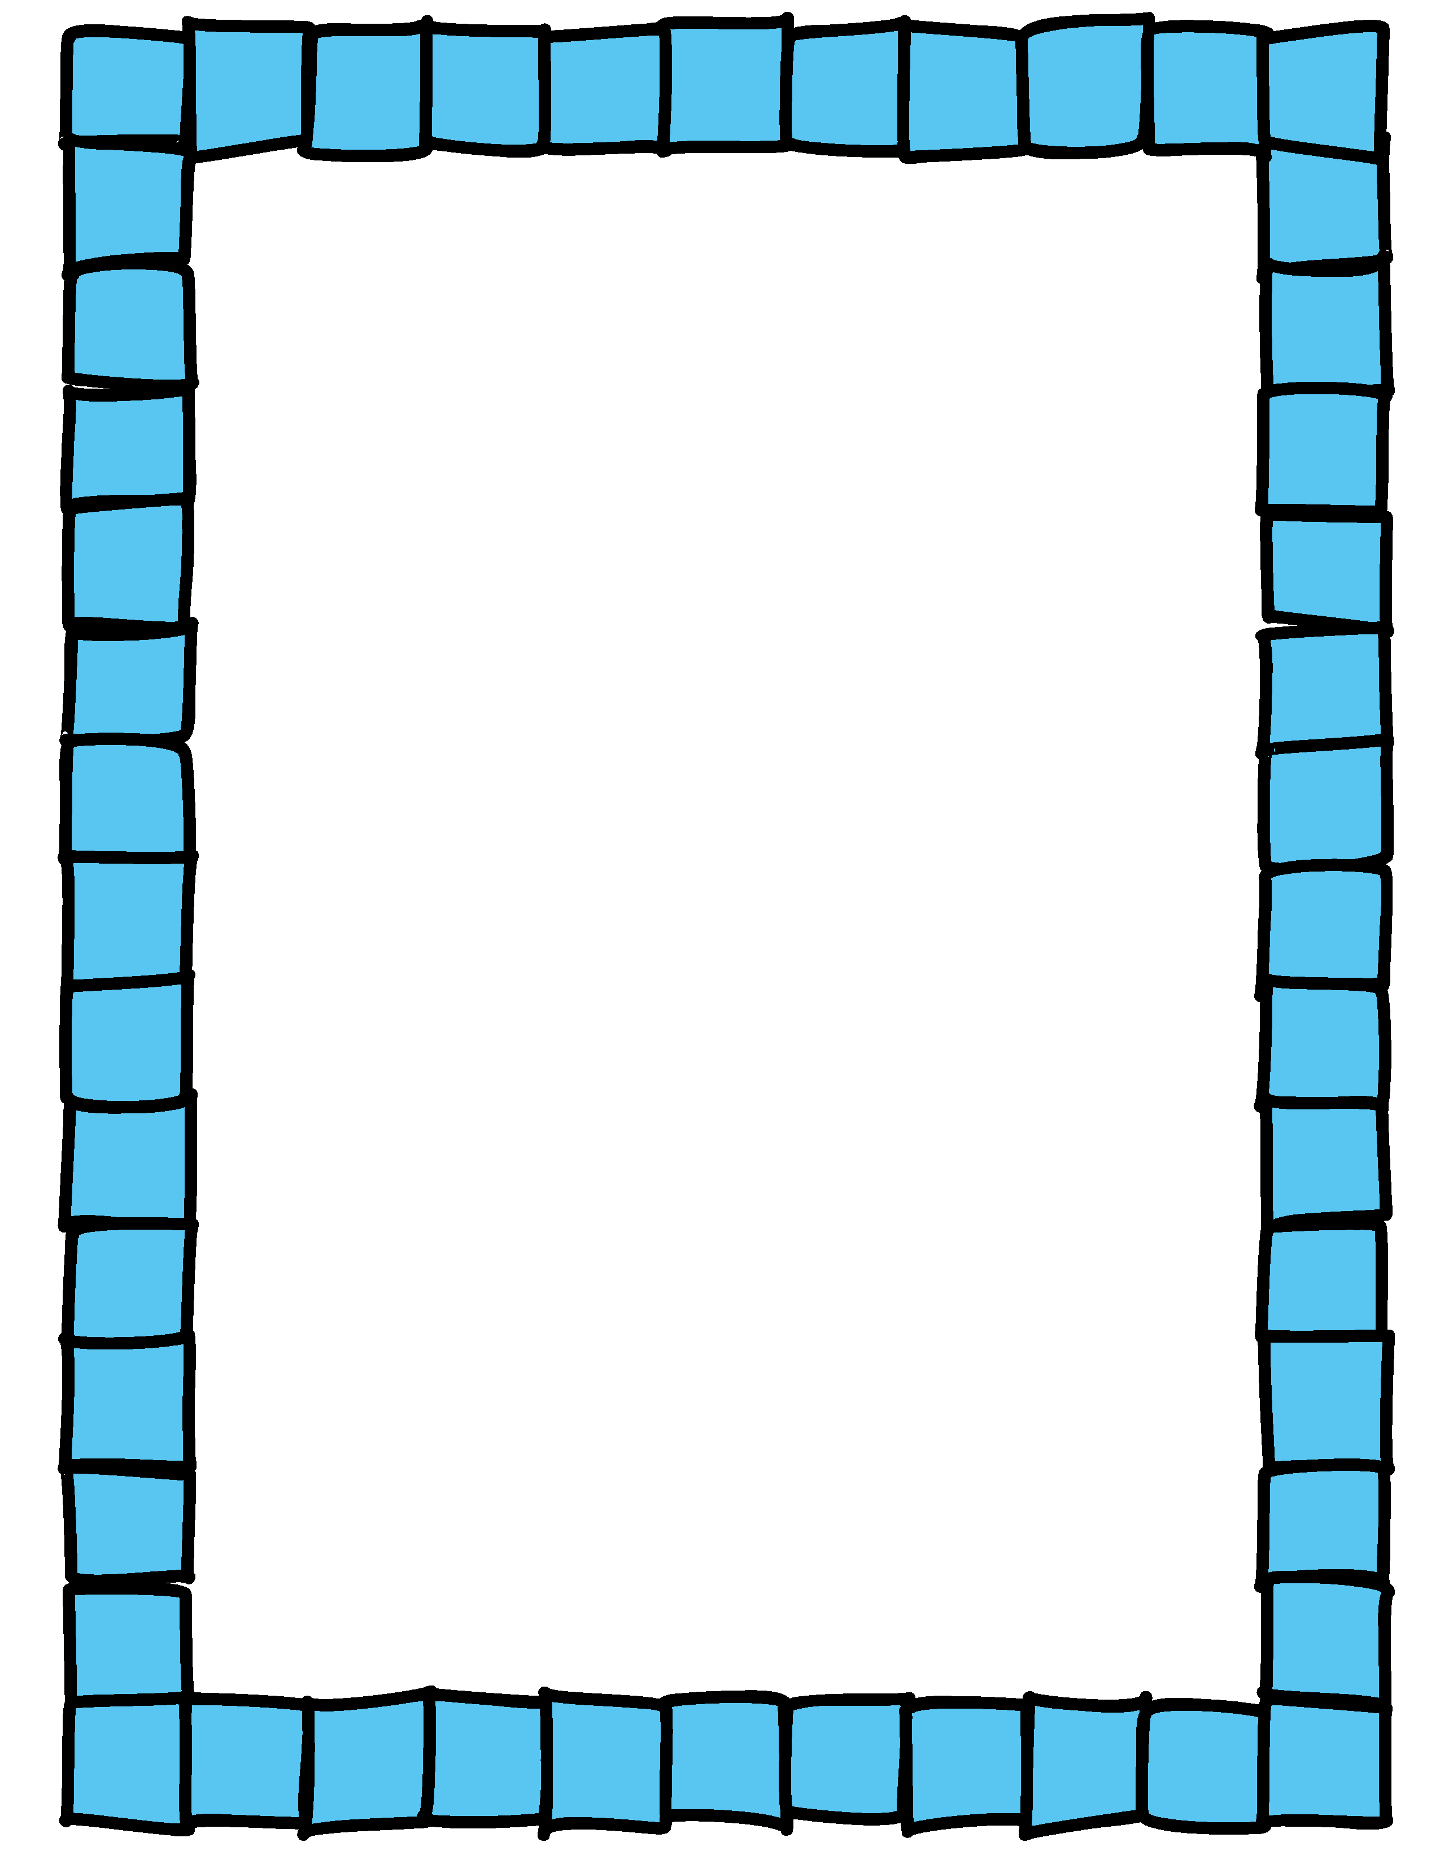
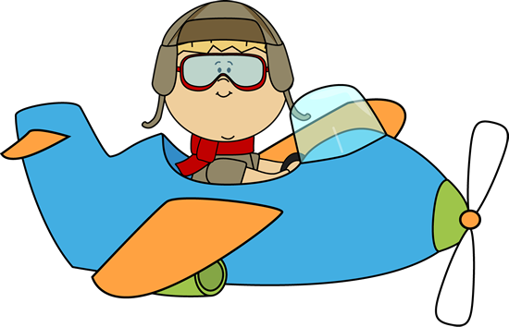
Plane Race

Slide 2
Plane Race
A Flying High Competition
Object of the Game:
Answer the question correctly to move your plane forward
Be the first plane to cross the finish line

Slide 3
Plane Race: Class Competition
How to Play
Each player/team will choose a color of plane: Red, Pink, Yellow, Purple, or Blue
The teacher asks the first team a question
Correct Answer
Incorrect Answer
Player/Team moves their plane forward by clicking on the matching color box.
Play goes to the next team
The next player/team takes a turn. Play continues until a team answers eight correct questions and advances to the flags.

Slide 4
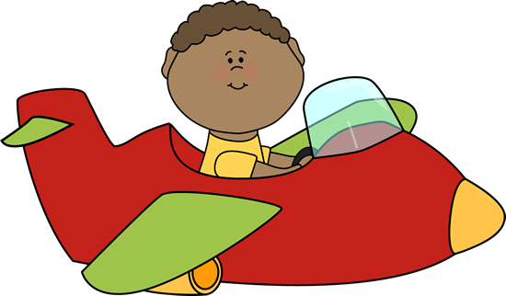
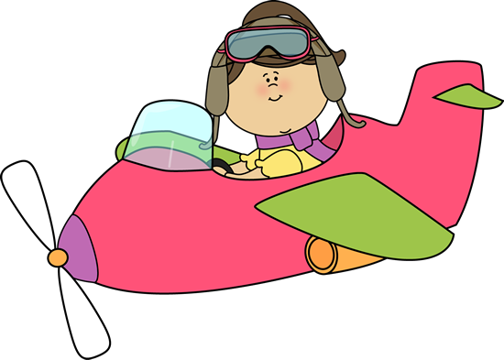
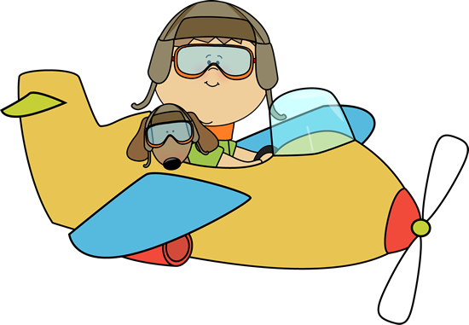
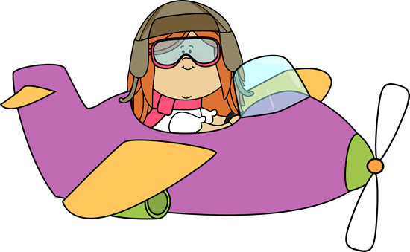
Red Plane
Pink Plane
Yellow Plane
Purple Plane
Blue Plane

Slide 5
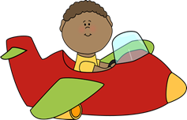
Credits:
PowerPoint Created by Pamela Moeai
Graphics by MyCuteGraphics.com
Cover Border by Graphics From the Pond
For more fun lesson plans and activities, visit my Teachers Pay Teachers store @
http://www.teacherspayteachers.com/Store/Pamela-Moeai

