Slide 1
Would You Rather?
Celebrating Our Differences
Silly Question Game
Created by
TEACHERS UNLEASHED

Slide 2
RULES OF THE GAME
Each question will have two options.
You MUST pick one of the options, even if you don’t like either.
You must form a team of 2, 3, or 4 people who made the same choice.
Discuss your decision with your team.
THERE IS NO WINNER, THIS GAME IS FOR FUN!

Slide 3
Are You Ready? Let’s Play!

Slide 4
Would You Rather?
Explore space…
Team of 3
Explore the ocean.
Team of 4
or

Slide 5
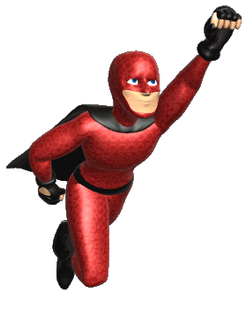
Would You Rather?
Stop time…
Team of 2
Fly.
Team of 3
or

Slide 6
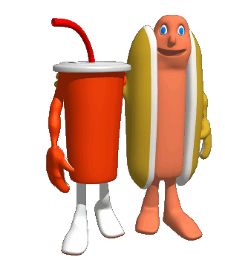
Would You Rather?
Watch no television for the rest of your life…
Team of 3
Eat no junk food for the rest of your life.
Team of 2
or

Slide 7
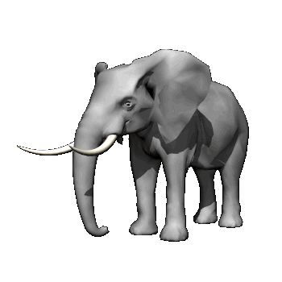
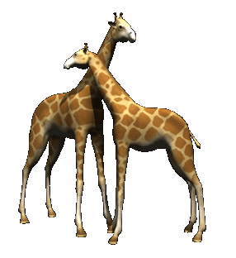
Would You Rather?
Have an elephant’s trunk…
Team of 4
Have the neck of a giraffe.
Team of 2
or

Slide 8
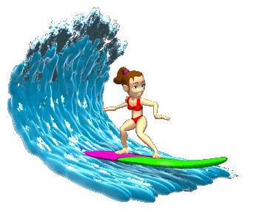
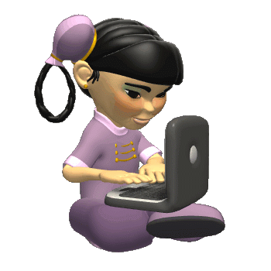
Would You Rather?
Surf the internet…
Team of 3
Surf the ocean.
Team of 4
or

Slide 9
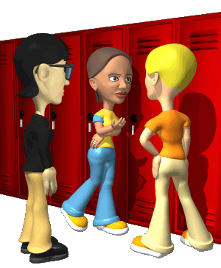
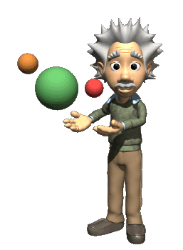
Would You Rather?
Be popular…
Team of 4
Be smart.
Team of 5
or

Slide 10
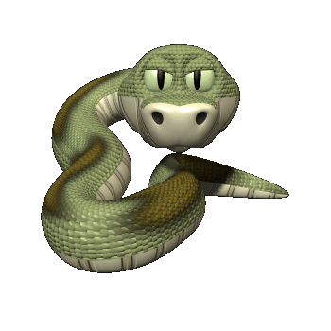
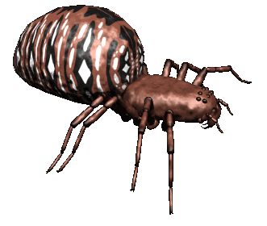
Would You Rather?
Have 500 spiders crawling in your house…
Team of 4
Have 100 snakes slithering in your bedroom.
Team of 3
or

Slide 11
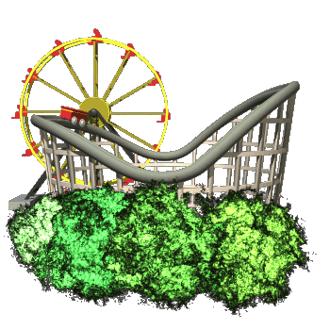
Would You Rather?
Live at Disneyland…
Team of 2
Live at
Sea World.
Team of 3
or

Slide 12
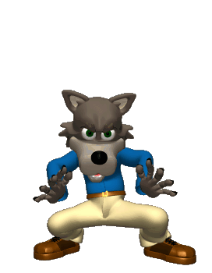
Would You Rather?
Be a vampire…
Team of 5
Be a werewolf.
Team of 3
or

Slide 13
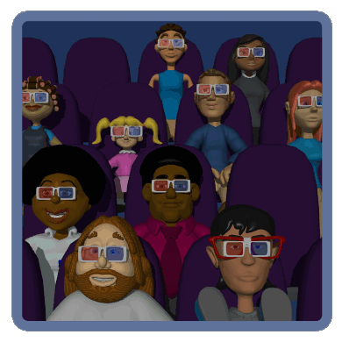
Would You Rather?
See the same movie over and over…
Team of 5
Hear the same song over and
over.
Team of 3
or

Slide 14
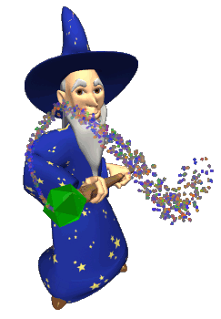
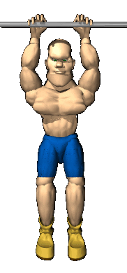
Would You Rather?
Have a magical power to save the world…
Team of 2
Be the strongest person in the
World.
Team of 3
or

Slide 15
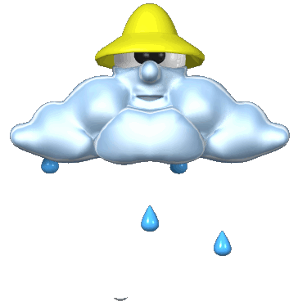
Would You Rather?
It rained every day…
Team of 3
It snowed every day.
Team of 2
or

Slide 16
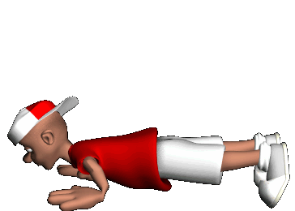
Would You Rather?
Sing on stage with One Direction…
Team of 4
Dance on stage with Selena Gomez.
Team of 3
or

Slide 17
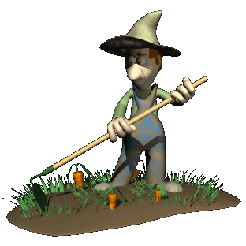
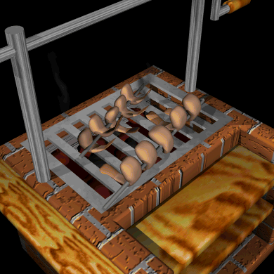
Would You Rather?
Grow all your own food…
Team of 3
Eat shrimp every day.
Team of 2
or

Slide 18
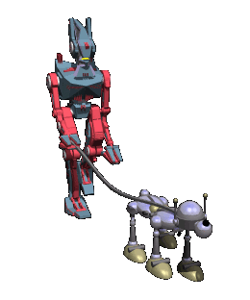
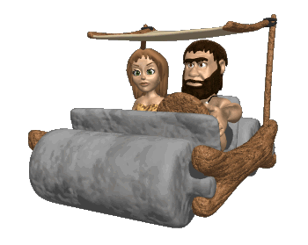
Would You Rather?
Travel 2000 years into the past…
Team of 2
Travel 2000 years into the future.
Team of 3
or

