Slide 1
Win 10 Training
Notes:
This training is designed to be simple to follow and a hands on experience for the teachers. I would suggest you bring your teachers to a lab so they can practice as you go through the slides.

Slide 2
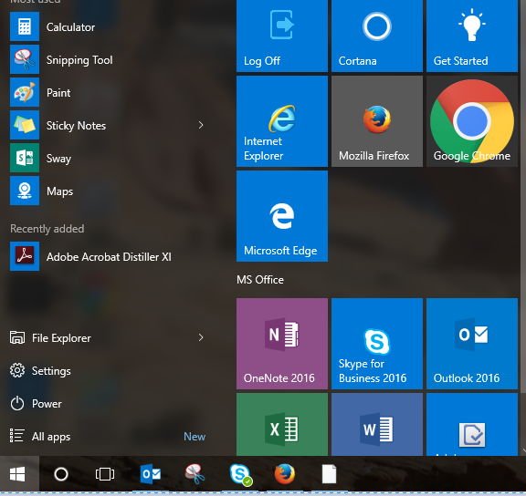
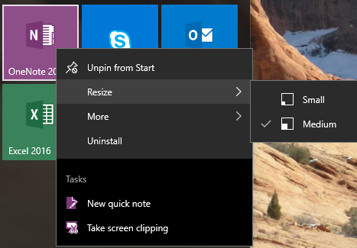
The New Start Menu
The Start menu looks a bit different, but it has all the usual features you’d expect — a list of all your installed applications as well as power options for shutting down or restarting your PC.
This is the Start icon click on it to open the start menu.
These tiles are called Live Tiles. You can arrange them by dragging and dropping.
To remove a tile right click and select Unpin from Start.
A nice feature is the ability to resize your tiles and customize. Simply right click and hover over resize you will see an option menu open that allows you to select your size of tile.
Notes:
Have teachers try moving tiles and resizing them.

Slide 3
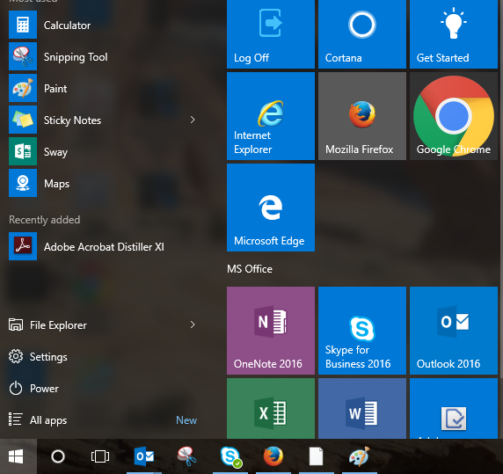
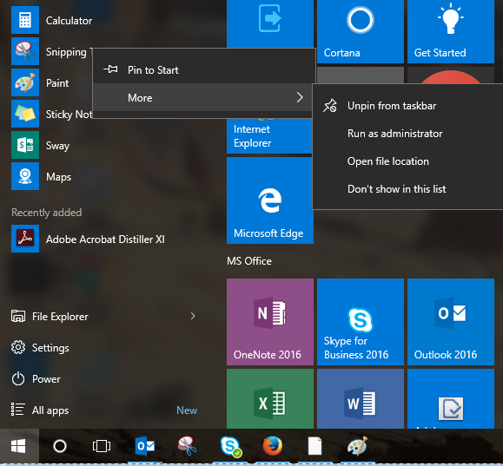
All Apps
All apps was formerly known as All programs. Simply click and it will list all the apps (programs) installed on the computer alphabetically.
To add an app to the Live Tiles just right click and select Pin to Start. This is also the location that you can add apps to your taskbar. You can drag and drop icons to the taskbar.
Taskbar
Notes:
Practice pinning and dragging and dropping. It might also be worthwhile to teach students how to add the Log Off icon to the taskbar.

Slide 4
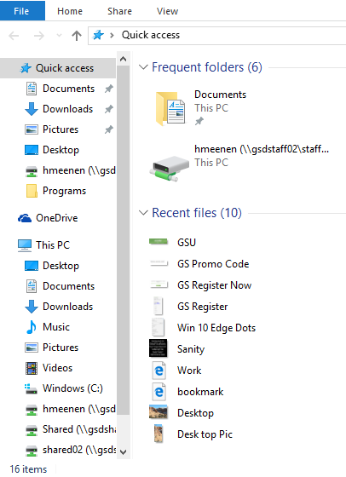
File Explorer
File Explorer is where you will find access to your computer drives.
When you open File Explorer you will find your M drive and Shared drive.

Slide 5
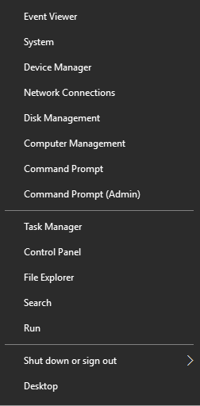
Search
Search can be one of the most efficient features of Windows 10. There are many ways to conduct a search. Generally, three letters into a word will produce not only a query of apps, but also files and photos.
One way is to click on start icon and start typing the term you are searching for.
Another way to search is to right click on the start menu. A menu with many options will open.
Notes:
Further on in the New Features section of the training there is more information about changing Cortana into a search icon if that is something that is important to teachers. Have teachers practice searching it is so efficient.

Slide 6
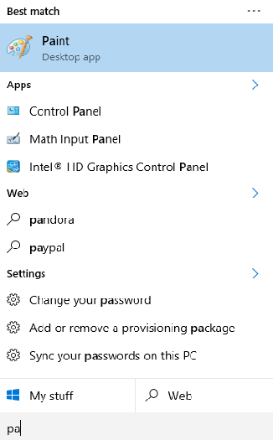
Search Continued
Once you conduct a search you will find that it will come up with a Best match first. The computer will also search Apps, Web, Settings, Photos, and Files.
Notes:
Further on in the New Features section of the training there is more information about changing Cortana into a search icon if that is something that is important to teachers. Have teachers practice searching it is so efficient.

Slide 7
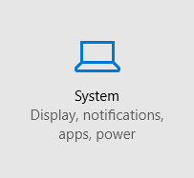
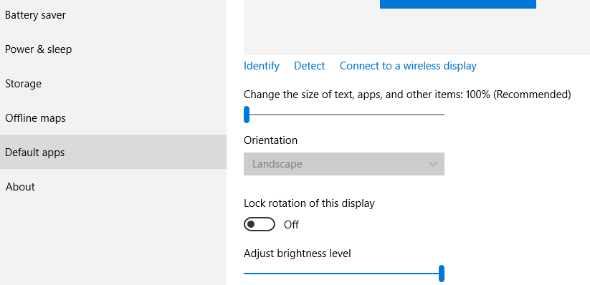
Setting Default Applications
Windows 10 will automatically default to the Edge Browser. This browser is very new and may not run all the website you may use. To change the default settings is very simple.
Click on settings in the start menu.
When the window opens click on System
From there click on Default apps
Notes:
I had to put this information on two slides so continue to slide #7 to finish setting defaults.

Slide 8
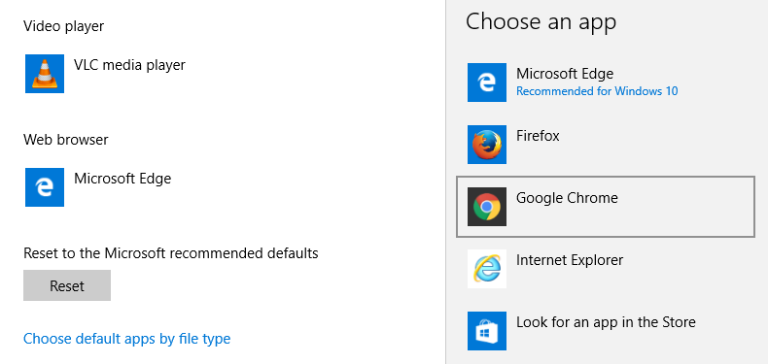
Setting Default Applications Continued
You will see a window open with several applications that run various items on your computer find the one that is titled Web browser click on the icon for Microsoft Edge and then a window will open that will allow you to select the browser you would like to have as the default.
Notes:
This might be a good time to set other defaults. Like VLC media player or Quicktime for the video player.

Slide 9
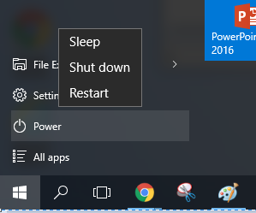
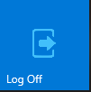
Shutting Down and Logging Off
Shutting down and logging off of your computer has changed with Windows 10.
Power icon
Found on the start menu.
This is where you will go to Shutdown or Restart your computer.
Logging Off
Found on the Live Tiles (once you click the icon you will be instantly logged off)
You might consider dragging this icon to the taskbar (drag and drop icon to taskbar).
Notes:
Make it very clear that if Log Off is clicked it immediately logs them off even if applications are still open. It doesn't ask if you are sure it just logs you right off the computer.

Slide 10
New Features
The following slides are features that Microsoft has rolled out with Windows 10
Notes:
This section will cover the Edge Browser and Cortana. If your teachers are overwhelmed with what they have learned so far then maybe save this section and do as a Tech in 20 later on.

Slide 11
Edge Browser
To access Edge you need to do a search. You can click on the icon to add it to your Live Tiles. This is what the icon will look like.
The Edge browser has a little different look. However it still works like other browsers with tabs at the top. Please be aware that some websites won’t be compatible with it.

Slide 12
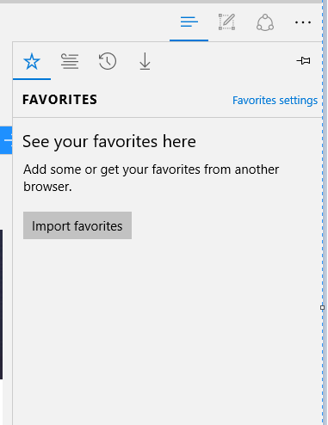
Edge Browser
Some of the features of the Edge Browser:
If you click on the three lines it will open this menu.
The star icon will house your favorite websites.
This icon is a Reading List to house sites you might want to look at later.
This icon is the browsing history.
The down arrow shows all downloads.

Slide 13
Edge Browser
Another unique feature is the ability to annotate on websites.
Clicking on the pencil icon will open the drawing feature.
The tab will turn purple and will provide a toolbar that allows you to draw, highlight, cut, etc.

Slide 14
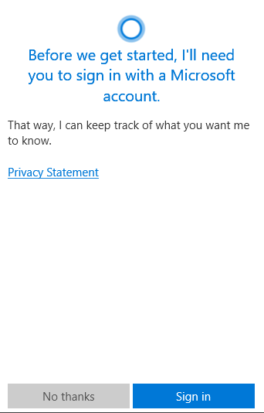
Cortana
A digital personal assistant. She works on voice commands.
To set up Cortana you will need to use a personal account like a Live.com, Hotmail, Outlook.com, or an MSN account.
You can opt out of setting it up and that will turn the icon in the taskbar to a search icon
Notes:
Please make it clear that teachers will need a personal Live, Hotmail, or Outlook.com account to activate Cortana. If they opt to not set it up then the icon will become the search icon.

Slide 15
Get Started
Interested in learning more? Then check out Get Started.
You can find Get Started in the Live Tiles on the Start Menu.
This will take you through some brief tutorials about
Windows 10
Microsoft Edge
Start Menu Tips
Getting Help

