Slide 1
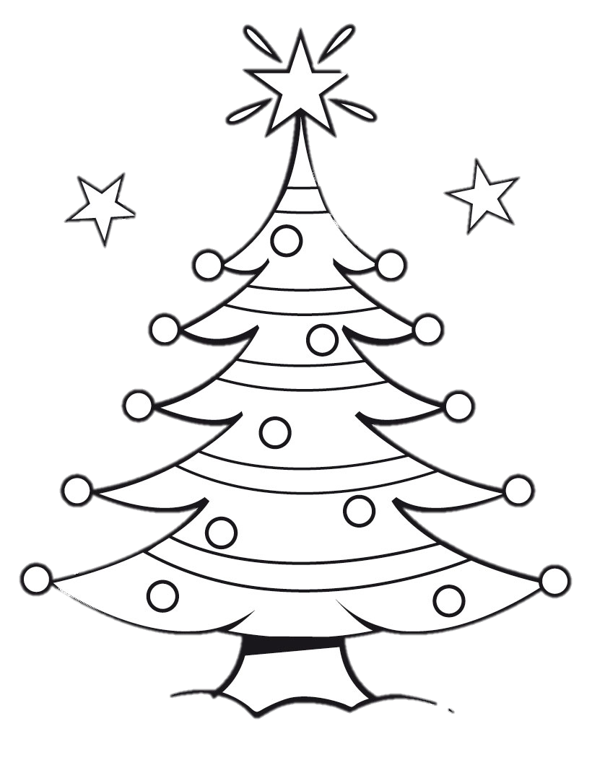
Would You Rather…
A Christmas Tree Glyph Activity

Slide 2
Would You Rather…
Or
Have to loudly sing the chorus of Jingle Bells every time you walk into a room for a week
Have to wear a Santa suit to school every day for a week

Slide 3
Would You Rather…
Or
Make presents for your family instead of buying them
Make ornaments for your Christmas tree instead of buying them.

Slide 4
Would You Rather…
Or
Not celebrate Christmas this year
Not celebrate your birthday this year

Slide 5
Would You Rather…
Or
Have Frosty the Snowman for a friend
Rudolph the Red-nosed Reindeer for a friend

Slide 6
Would You Rather…
Or
Have Christmas tree tinsel for hair
Have fingernails that light up like Christmas lights

Slide 7
Would You Rather…
Or
Write a five paragraph essay about the meaning of the holidays
Solve a page of Christmas-themed math problems

Slide 8
Would You Rather…
Or
Be at home on Christmas and get lots of presents
Go to Disneyland for Christmas but not get any presents

Slide 9
Would You Rather…
Or
Eat your cereal with eggnog instead of milk
Eat a candy cane sandwich

Slide 10
Would You Rather…
Or
Live in a giant gingerbread house
Ride on the Polar Express

Slide 11
Would You Rather…
Or
Be allowed to only eat fruitcake for two days
Be allowed to only eat candy canes for two days

Slide 12
Would You Rather…
Or
Have a nose that glows red like Rudolf’s
Have pointy ears like an elf

Slide 13
Would You Rather…
Or
Be given $100 for Christmas to buy things for yourself
Be given $1000 before Christmas to use to buy gifts for other people

Slide 14
Would You Rather…
Or
Get many small presents for Christmas
Get one big present for Christmas

Slide 15
Would You Rather…
Or
Have a job wrapping presents at the mall
Have a job taking pictures of children sitting on Santa’s lap at the mall

Slide 16
Would You Rather…
Or
Be one of Santa’s elves
Be one of Santa’s reindeer

Slide 17
Would You Rather…
Or
Spend a day watching Christmas videos
Spend a day Christmas shopping at the mall

Slide 18
Would You Rather…
Or
Have to loudly sing the chorus of Jingle Bells every time you walk into a room for a week
Have to wear a Santa suit to school every day for a week

Slide 19
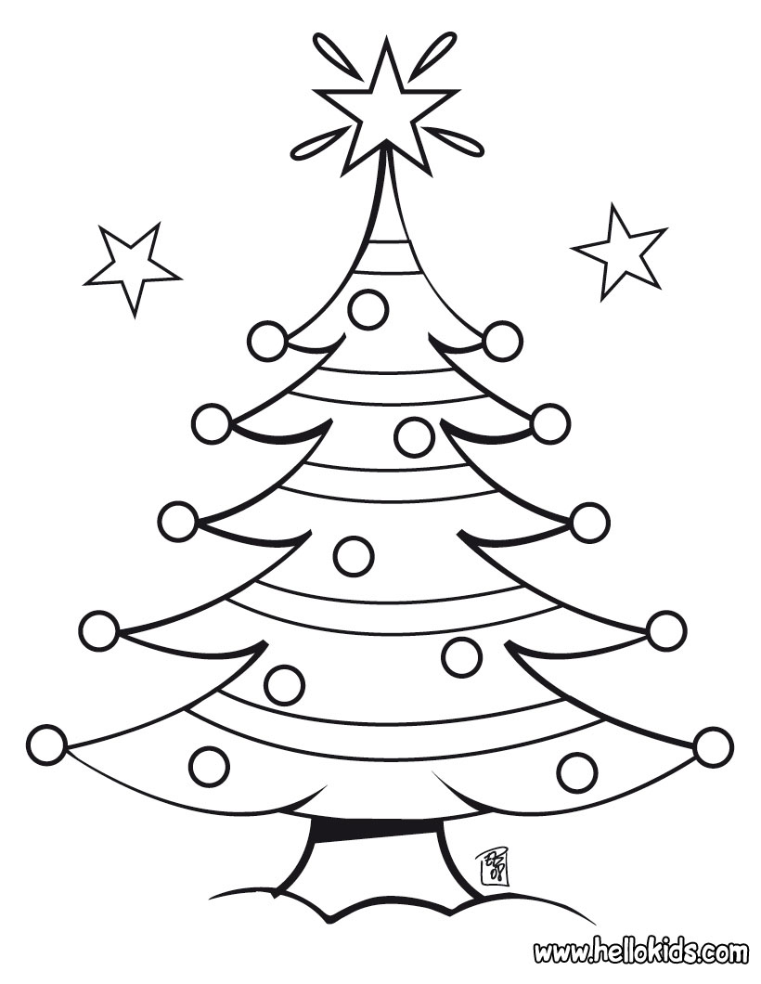
Now…decorate your tree with your choice of decorations. Just no more red or green ornaments

