Slide 1
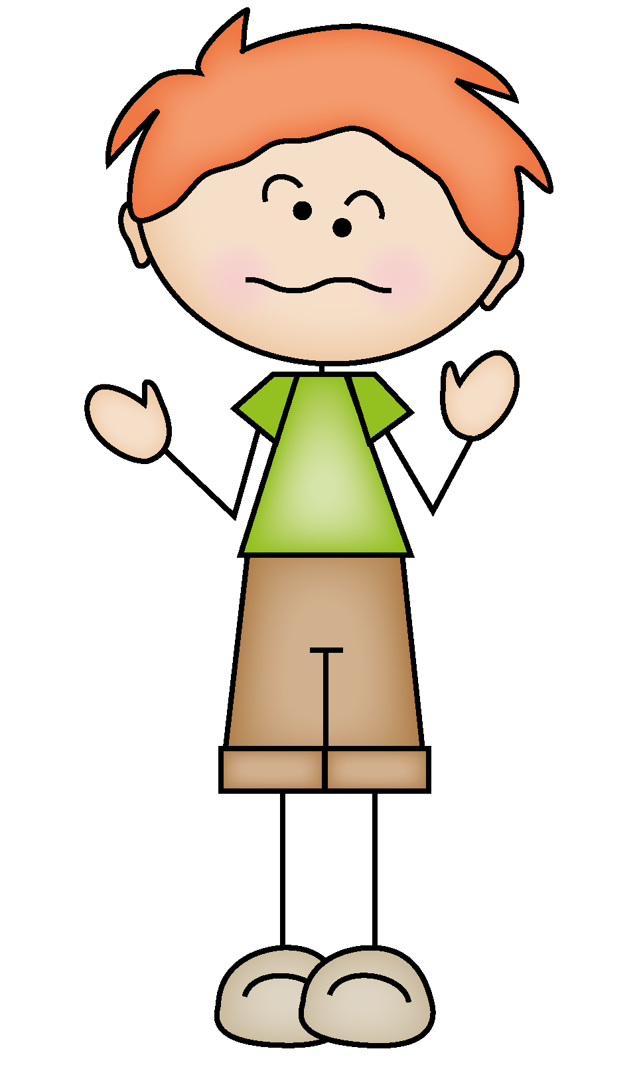
What would YOU rather do? Use the worksheet to record your answers to the following questions.
When you are finished, take some time to find someone that matches your answers.
Be sure to have them write their name in the space provided.

Slide 2
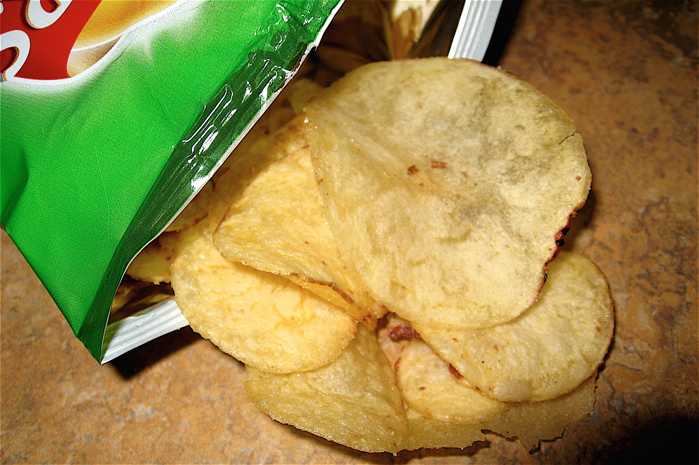
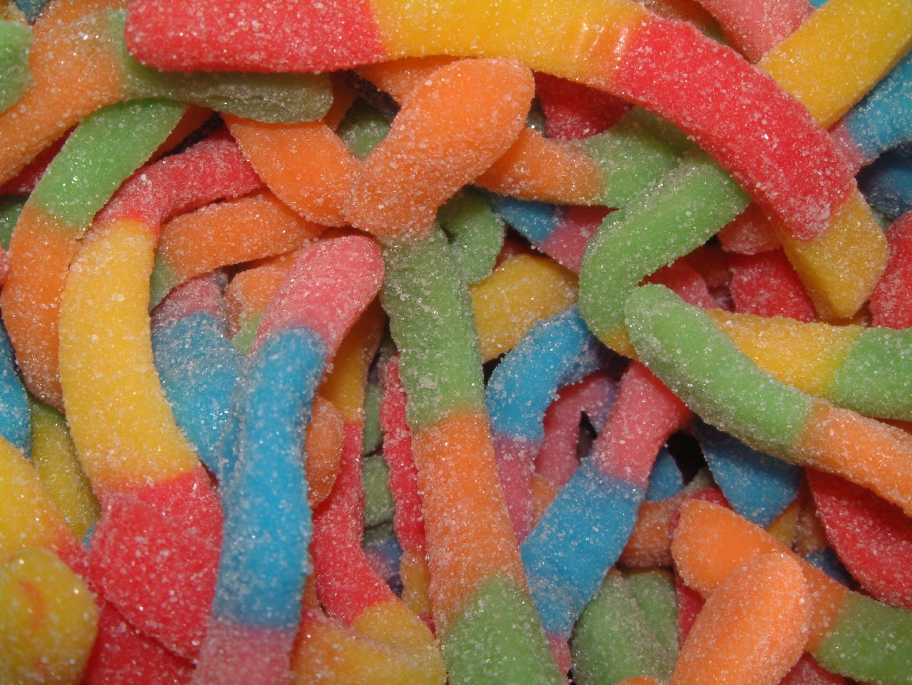
1
ORANGE
YELLOW
OR
Eat Salty Chips
Eat Sour Candy

Slide 3
2
BLUE
PURPLE
OR
be a Butterfly
be a Bee

Slide 4
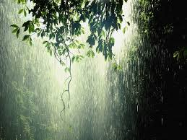
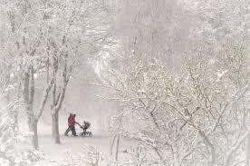
3
RED
GREEN
OR
be a Rainstorm
be a Snowstorm

Slide 5
4
BROWN
GRAY
OR
eat a live bug
eat a dead worm

Slide 6
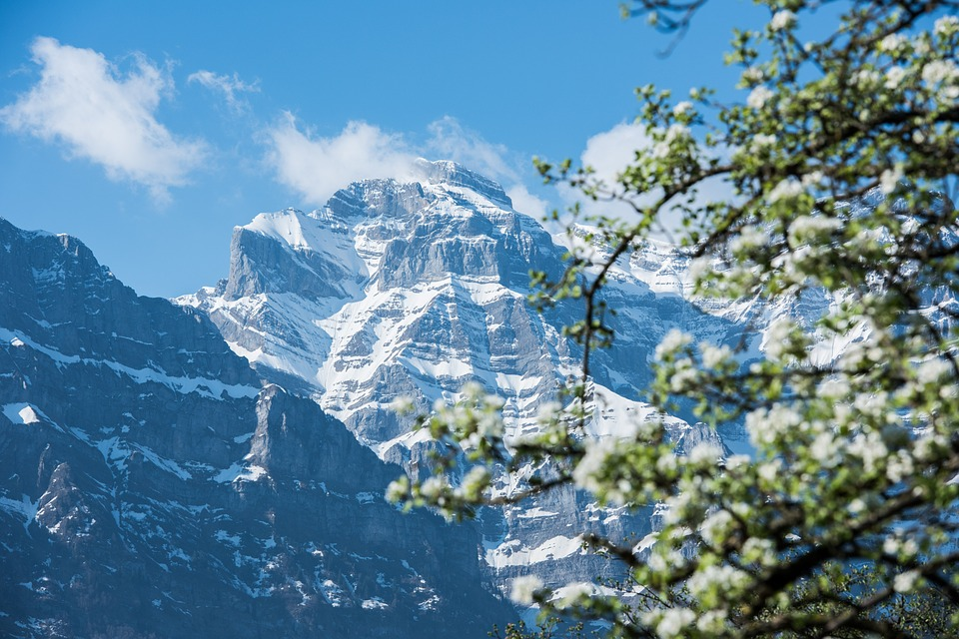
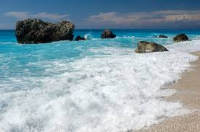
5
BLACK
WHITE
OR
go to the mountains
Go to the beach

Slide 7
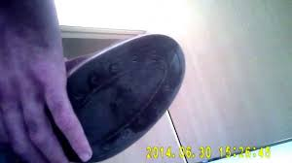
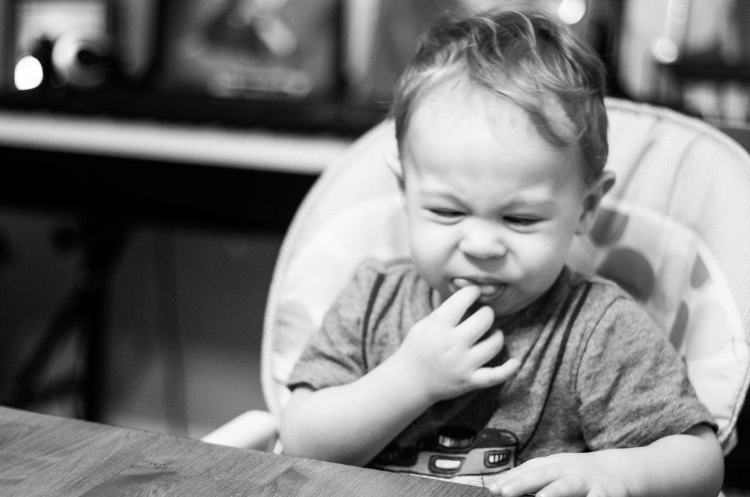
6
ORANGE
YELLOW
OR
Lick the bottom of your shoe
Eat your boogers

Slide 8
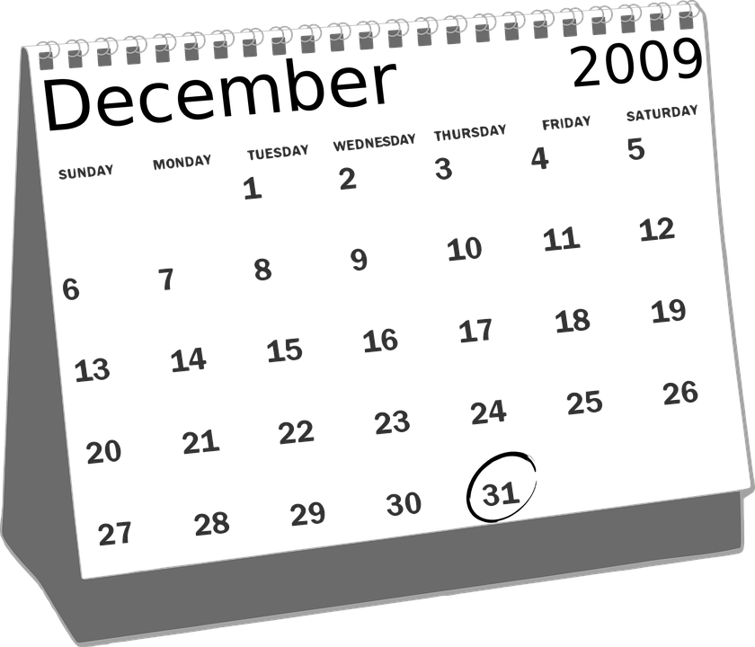
7
BLUE
PURPLE
OR
Have the month of December completely off
Have a three week Spring Break

Slide 9
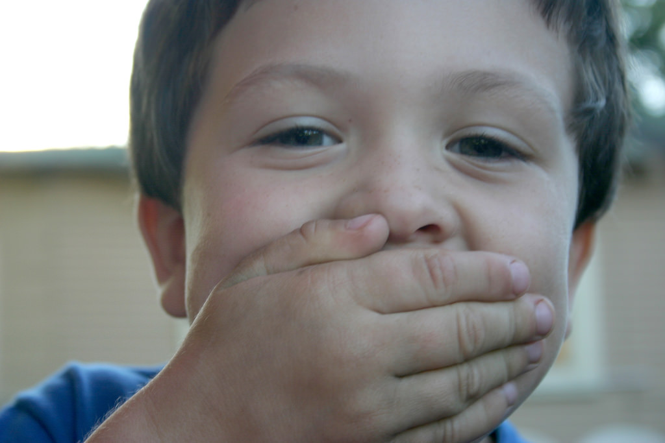
8
ORANGE
GREEN
OR
Have to say everything you are thinking
Never say anything again

Slide 10
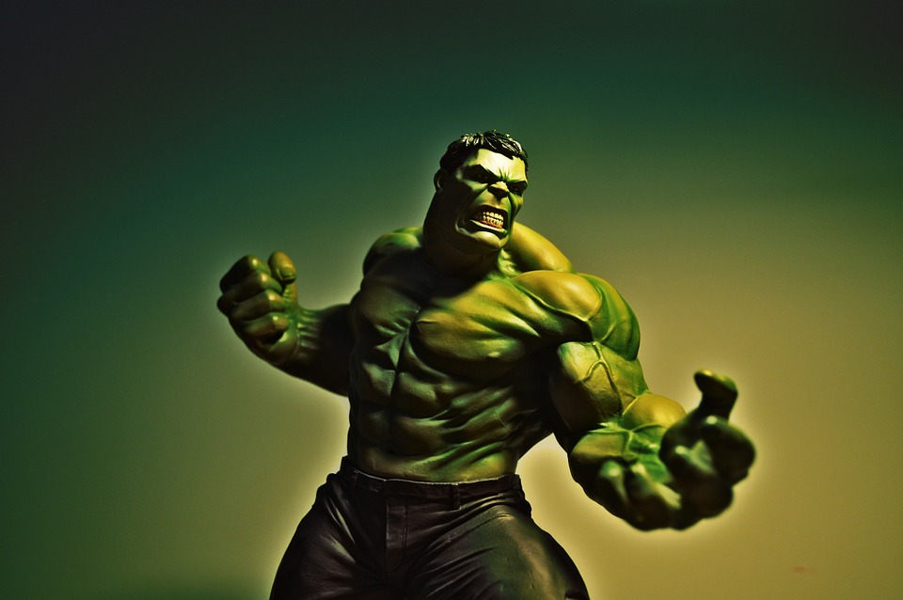
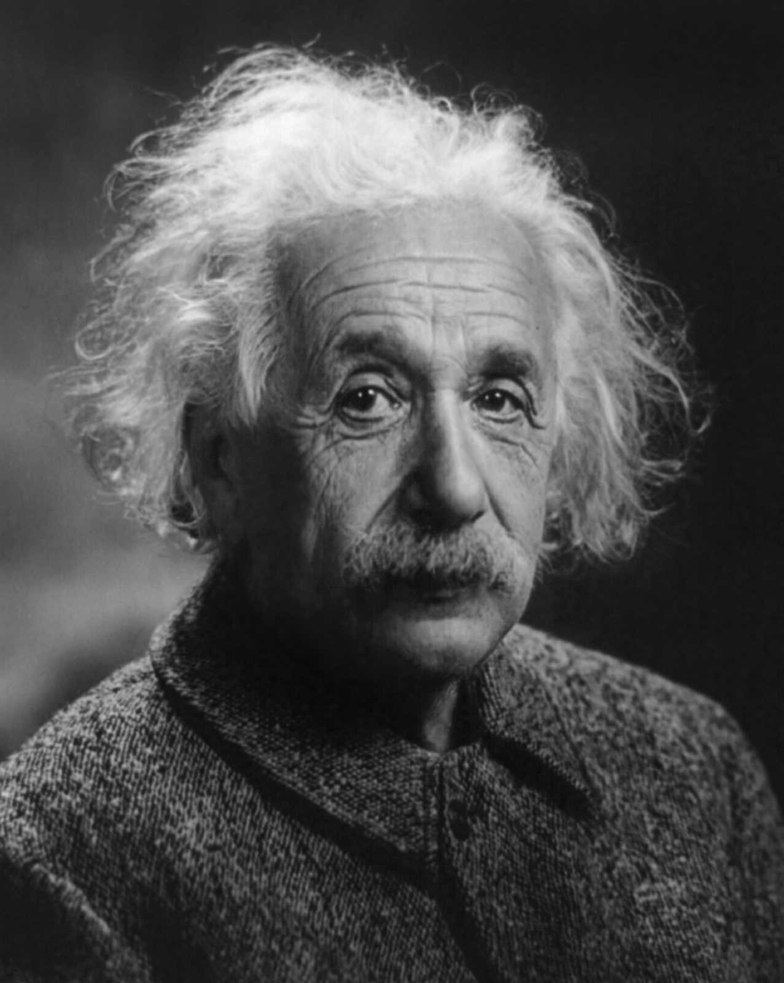
9
BROWN
GRAY
OR
Be super strong
Be super smart

Slide 11
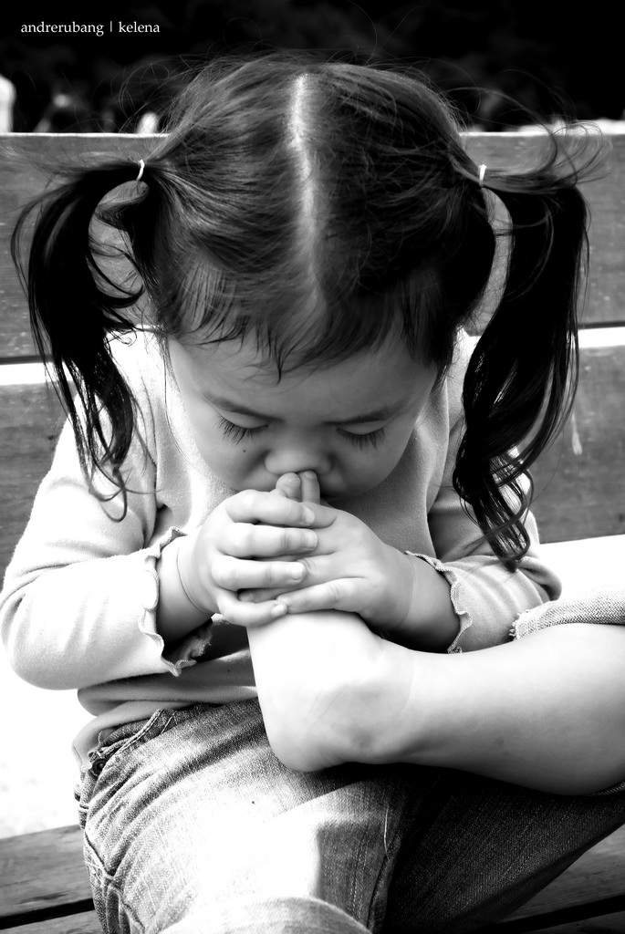
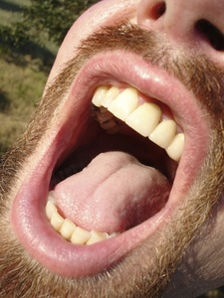
10
BLACK
WHITE
OR
Have stinky feet
Have bad breath

Slide 12
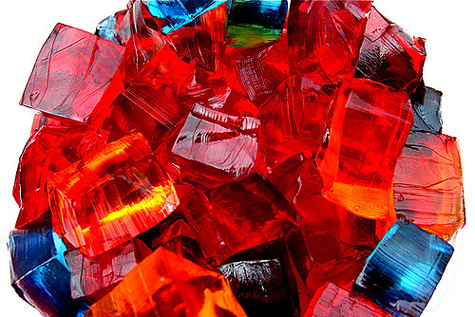
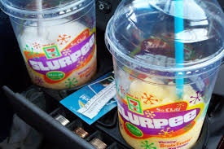
11
ORANGE
YELLOW
OR
Jump into a pool filled with Jell-O
Jump into a pool filled with Slurpees

Slide 13
12
BLUE
PURPLE
OR
Never take a shower again
Never brush your teeth again

